Slide 1
Personnel PIL
With a Focus on High Quality Instructors
Karen Brock
July 23, 2019

Slide 2
Agenda
Welcome and Introductions
Hiring high-quality Instructional and Administrative Staff
Induction Plan - Keeping high-quality Instructors
Performance Improvement Plans (PIP)
Job-embedded Assignment / Due Dates

Slide 3
Key Concepts / Goals
Hiring – create/modify a hiring process from advertising to offering the position to ensure high quality instructors
Induction – review/revise induction plan and mentor selection/training to retain high quality instructors
Personal Improvement Plan (PIP) – create a PIP based on a simulated case study using measurable performance goals

Slide 4
Hiring High Quality Instructors
Roles of JOC, Solicitor, CBA, school policy (do you have one)?
Job Description
Advertising
Criteria for Interviewing Candidates
EEOC and Veterans/Affirmative Action
Interview Process/procedure
Follow-up to the interview

Slide 5
Small Group discussions Job Description & Advertising
Characteristics of a good job description
What, when and where do you advertise?
Notes:
Pull up sample job description

Slide 6
Interview Process
How do you select the candidates?
What are the interview procedures? More than one interview? Reference checks?
What are good interview questions?
Interview committee?
Notes:
Pull up sample interview procedures: lesson, interview questions

Slide 7
Induction Plan
Who are you hiring?
What do your new instructors need? Want?
Traditionalists – born before 1945.
Baby Boomers – born 1946 to 1964.
Generation X – born 1965 to 1980.
Generation Y or Millennials – born 1981 to 1995.
Generation Z – born 1996 to 2012
www.youtube.com/watch?v=Dg99LxpLKkU

Slide 9
Purpose of Induction Plan
Provide a mentor
Qualifications for a mentor?
Paid position? Check CBA
Support instructor
Certification process
Professional engagement
Routines / required activities

Slide 10
Small Group Discussion
What kind of training and follow-up should be provided to the mentor?
What activities / events should be in an induction plan?
How should the induction plan continue into year 2 and 3?
Notes:
Sample induction plan

Slide 11
Performance Improvement Plan (PIP)
Provide a more structured method of support for new instructors
Check CBA and School Policy
Always discuss with your solicitor
Writing a good PIP is important

Slide 12
Components of a PIP
Role of observational data and student achievement data
Small group discussions
Performance Goals and are they measurable
Monitoring and evaluating progress
Timelines are important
Is the PD aligned to the school’s instructional and curricular goals?
Refer to your evaluation tool

Slide 13
Components of a PIP
Is PD aligned to the unique needs of the teacher?
Does the PIP conform to high standards of honesty, integrity and confidentiality?
Has the PIP been approved by the solicitor and SCA?
How is this accomplished?

Slide 14
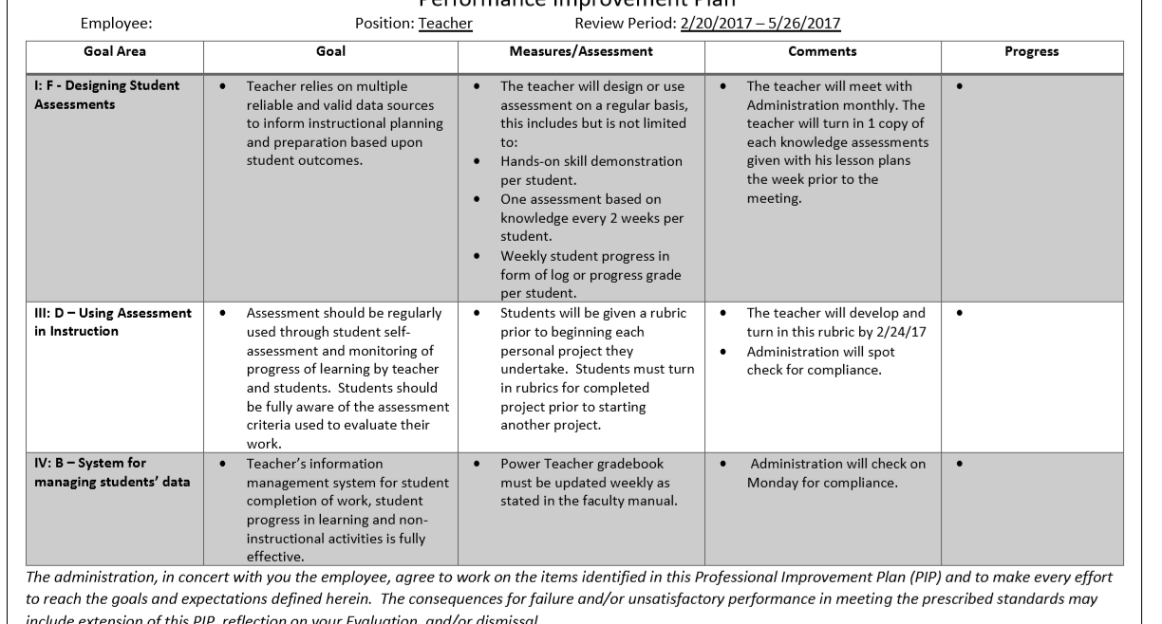

Slide 15
Job-Embedded Assignments
Create or revise an existing hiring procedure for their school system for teachers and administrators to ensure high-quality, high performance instructional staff
Review and existing teaching induction program for teachers through at least the first year to a maximum of three years

Slide 16
Job-Embedded Assignments
Read Handout #1 regarding an ethical and confidentiality dilemma. Write a narrative explanation of how you would respond and why you responded that way. Explain how the response is compatible with ethical behavior and confidentiality.
Read Handout #2 regarding a simulated case study, you will create a performance improvement plan for the teacher that is based on objective data and student achievement data. The plan will include measurable performance goals

Slide 17
On-line sessions
There will be two on-line sessions for help/questions/sharing
Will be optional as long as assignments are being turned in on time
Dates for online meetings – October 9th and November 12th at 9 AM
Look on the Announcement page for details

Slide 18
Next meeting
December 10th – Nittany Lion Inn (10am – 2 pm)
Presentation of job embedded assignment #1, 2 or 4. Your choice
Culminating assignment is uploading that presentation to Canvass
Course completion date 1/30/2020
PILS hours will be awarded after culminating assignment is completed

