Slide 1
Teacher Induction and Mentoring
Dr. Gerald Witmer
PIL Facilitator

Slide 2
Why?
The central purpose of school administration is to bring about changes to the QUALITY of learning experiences offered to students

Slide 3
INDUCTION

Slide 4
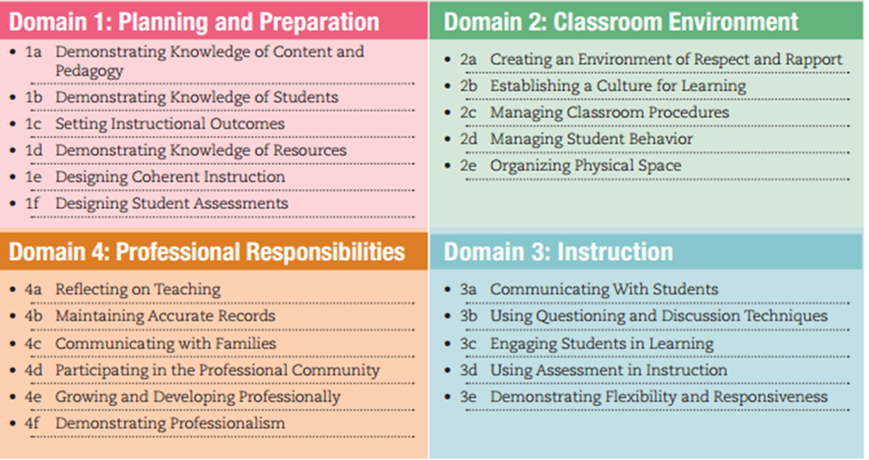
Educator Effectiveness

Slide 5
Induction Planning
SY 2022-2023 and 2023-2024
One-Year Plan Required
Educator Induction Plan Guidelines (February 2019)
SY 2024-2025
Two-Year Plan Required
Amendments to 49.16(a)

Slide 6
The Induction Team
The educator induction team is responsible for the development and operation of the induction program. The team should include __________________________
The educator induction team should be responsible to oversee the following:
Representation on the committee
The implementation of meaningful needs assessment activities
The implementation of an appropriate educator induction program
The facilitation of an annual evaluation of educator induction program

Slide 7
2024-2025
Each school entity shall submit to the Department for approval a plan for a 2-year induction experience for:
first year teachers
long-term substitutes who are hired for a position for 45 days or more, and
educational specialists
The induction plan shall reflect a mentor relationship between the first-year teacher, long-term substitute or educational specialist, teacher educator and the induction team, and the mentor relationship should continue for the length of the program.

Slide 8
Induction Plan Topics - Required
Professional Ethics Program Framework Guidelines
Culturally Relevant and Sustaining Education Program Framework Guidelines (CR-SE)
Educator Effectiveness
Teacher Competency
Student Learning

Slide 9
Professional Ethics Program Framework Guidelines
The standards of behavior, values, and principles that inform and guide professional decision-making. These standards of behavior, values and principles include those detailed in the Pennsylvania Model Code of Ethics for Educators, as adopted by the Professional Standards and Practices Commission.
Continuing PDP and Ed Prep (SY 2023-2024)
Induction Programs (SY 2024-2025)

Slide 10
Culturally Relevant and Sustaining Education Program Framework Guidelines (CR-SE)
Education that ensures equity for all students and seeks to eliminate systemic institutional racial and cultural barriers that inhibit the success of all students in this Commonwealth—particularly those who have been historically underrepresented. Culturally relevant and sustaining education encompasses skills for educators including, but not limited to, approaches to mental wellness, trauma- informed approaches to instruction, technological and virtual engagement, cultural awareness and emerging factors that inhibit equitable access for all students in this Commonwealth.
Continuing PDP and Ed Prep (SY 2023-2024)
Induction Programs (SY 2024-2025)

Slide 11
MENTORING

Slide 12
Identification of Mentors
Chapter 49 requires a mentor relationship between the inductee and the induction team. Mentors should be identified and designated by administration and then approved by the Induction Team in consideration of the following attributes:
Similar certification and assignment
Outstanding work performance
Models continuous learning and reflection
Knowledge of district/school policies, procedures and resources
Ability to work with students and other adults
Willingness to accept additional responsibility
Mentor training or previous experience
Developing good assessments that are based on standards and eligible content
Data analysis training

Slide 13
The Questions Around Teacher Development
Initial Orientation: Learning About the School
How do you learn to plan and teach?
How do you plan curriculum?
How do you manage student behavior?
Improved Professional Practice
How do you learn to improve teaching practice?
What do you do to make it work better?
How do you reflect – for…in…and on teaching? - in teaching?
Developing a Professional Learning Community
What needs to be done to develop a collaborative community of learners

Slide 14
Mentor Responsibilities
Instructional support such as:
Classroom management
Standards-based instructional planning and implementation
Standards-aligned teaching strategies
Differentiated instruction and supports for struggling students
Observations and conferencing with the beginning teacher
Instruction for diverse learners in inclusive settings, including ELLs and IEPs
Data-informed decision making

Slide 15
Mentor Responsibilities
Professional support such as:
Information about school policies and procedures
Student formative and summative assessments and evaluation
Educator Effectiveness in accordance with Act 13 of 2020
Information about quality professional development opportunities
Personal support such as:
Introductions to other faculty and administrators
Personal encouragement within the context of a confidential relationship
Liaison for networking purposes - key people and resources

Slide 16
Resources
Mercer CTC Guide Tied to Educator Effectiveness
The Alberta Teachers Association
Educator Induction and Mentor Guide - Franklin County CTC

Slide 17
Question/Comment

Slide 18
Coming Attractions…
We are officially half-way through the course.
On Friday (March 17) your Induction Plan is due.
Next session (March 23rd) will be on “Developing a Performance Improvement Plan”, and Mr. Wes Kuchta the Administrative Director at Lenape Technical School will be presenting.
The following session (April 5th), Dr. Michael Stauffer, Executive Director of the Berks Career & Technology Center will be presenting on PIPs as well.
At this point, you should be turning your focus toward Job Embedded Assignment #3 which involves the selection and training of mentors, which is due next Thursday (March 23rd)
We are officially 56 days away from presenting your culminating projects.

